Slide 1

Monthly Claim System – Part 3
Final POE – Automation & Workflow Enhancements
Student Name: ARMALENE MAGERMAN-ST10454097
Module: PROG6121
Date: 21 NOVEMBER 2025

Slide 2
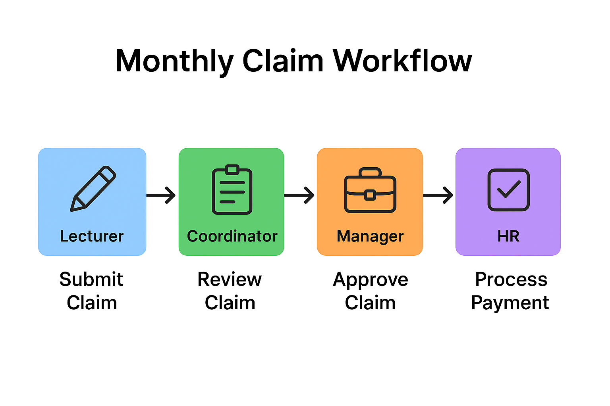
Introduction to the Monthly Claim System
Automates claim submission, approval, and HR processing.
Part 3 focused on usability, role-based access, automation, and validation.
Reduces manual errors and speeds up workflow.
Provides a clear dashboard for all roles.

Slide 3
System Overview
Role-based workflow with four users:
Lecturer
Coordinator
Manager
HR.
Automatic calculation of payments and status updates.
Upload and management of supporting documents.
Dashboard provides clear summary of approved, pending, and rejected claims.

Slide 4
Part 3 Improvements
Improved UI and design: colour-coded dashboard, clear buttons, modern layout.
Added role-based login system.
Implemented validation and error handling.
Enhanced workflow automation: auto-calculation, claim tracking, approvals.

Slide 5

Automation Features
Lecturers: automatic claim submission, auto-calculation of payments.
Coordinators & Managers: automated verification and approval workflow.
HR: automated report generation for final claim processing.
Dashboard updates dynamically to reflect claim statuses.

Slide 6
User Roles & Workflow
Lecturer: submit claims, upload documents.
Coordinator: verify and approve claims.
Manager: final approval before HR.
HR: process approved claims and generate reports.
Each role only sees the relevant screens and buttons.

Slide 7
User Interface Enhancements
Modern colour scheme for clarity and aesthetics.
Header repositioned to top for improved structure.
Dashboard counters for approved, pending, rejected claims.
Improved spacing, font, and button styling for better usability.

Slide 8

Challenges
Implementing role-based login and permissions.
Keeping UI consistent and responsive across all screens.
Ensuring real-time updates in the dashboard.
Managing document uploads and verification workflow efficiently.

Slide 9
Reflection & Learning
Improved knowledge of C#, WPF, and event-driven programming.
Applied user-centred design principles for usability.
Learned to structure code for modularity and future scalability.
Gained practical experience in workflow automation and role-based systems.

Slide 10

Conclusion & References
Part 3 enhanced the Monthly Claim System with automation, UI improvements, validation, and role-based workflows.
System is now fully functional, professional, and ready for academic and practical use.
References (Harvard Style):
Microsoft. (2024). C# Documentation. Available at: https://learn.microsoft.com/
Microsoft. (2024). WPF Documentation. Available at: https://learn.microsoft.com/
StackOverflow. (2024). C# UI/Logic Discussions. Available at: https://stackoverflow.com/

